Slide 1
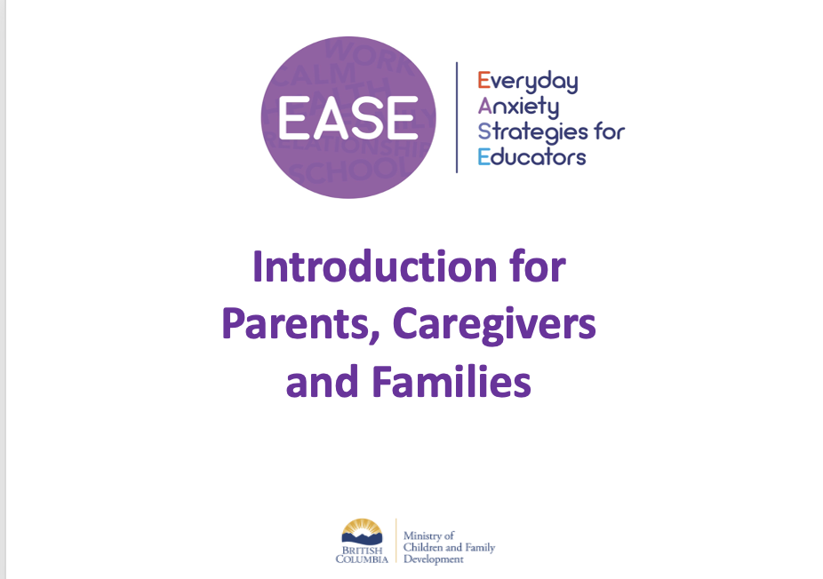
Easing Our Children’s Worries
At Homma Elementary
January 30, 2023

Slide 2
Introductions
Notes:
In person Session: Participants toss a ball or other soft object to each other.
When ball reaches them ask them to introduce themself and answer the question ‘why are you here’? Facilitator can jot these down on a whiteboard.
Virtual Session: Invite parents to introduce themself and age of their child, and one thing they love/appreciate about their child or one thing they are looking forward to getting out of the workshop today. Facilitator can jot these down on a virtual whiteboard if they wish.

Slide 3
Levels of Intervention Kaufman, M.J. (1996).
Universal
Targeted
Intensive
Notes:
EASE classroom lessons are ‘universal’, meaning ALL students can benefit from them.
Universal interventions are preventative and proactive in nature (examples include other Social and Emotional Learning Programs, classroom management strategies, etc.) - meaning they try to prevent mental health disorder or substance use problem from starting.
Although EASE lesson plans are designed for universal delivery by classroom teachers, they can be adapted for use with targeted groups or individual students.
Universal – 80% of students ONLY need these types of interventions
Targeted – 15% of students ALSO need more targeted, small group interventions
Intensive – 5% of students ALSO need individual, intensive interventions
Source: (for facilitator reference only)
Kaufman, M. J. (1996). Integrated approaches to preventing antisocial behavior patterns among school-age children and youth. Journal of Emotional and Behavioral Disorders, 4, 194 – 209.

Slide 4
EASE is based on
Cognitive Behavioural Therapy (CBT)
CBT explores the connections between thoughts, feelings, and behaviours
Notes:
EASE lessons are based on methods used as part of Cognitive Behavioural Therapy (CBT). The next slide introduces the CBT triangle model.
CBT has been shown to be a very effective tool for managing anxiety across ages and environments, including in schools.
The goal of CBT is to help individuals notice how their thoughts and behaviours influence the way they feel and to provide them with tools to think and do things differently.
It is a skills based/educational approach that focuses on the ‘here and now’ and what is MAINTAINING current problems and difficulties.
This brief video by Groundwork Counseling describes CBT https://youtu.be/5h_Zo90xWD8 if facilitators need a refresher.

Slide 5
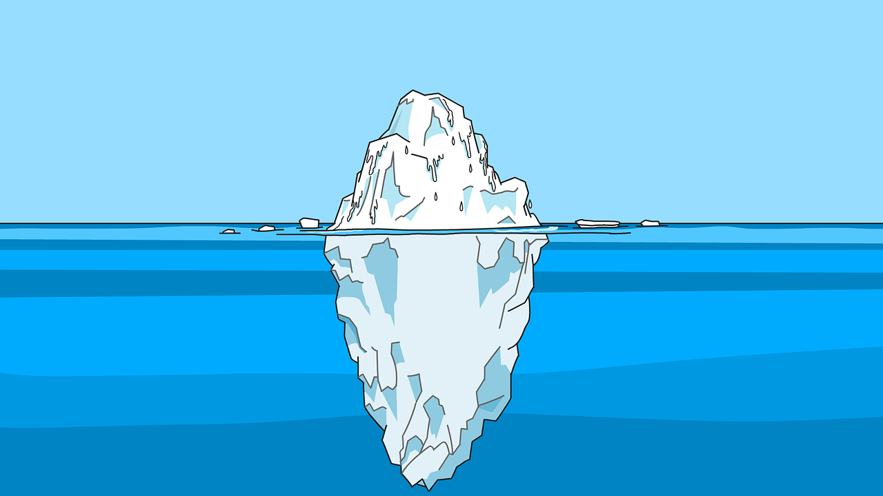
Behaviour
Anxiety
Thoughts
Feelings
Notes:
The CBT Model shows what an emotion is made up of.
All emotions are made up of complicated interactions between our thoughts, feelings and behaviour, including anxiety (click to add)
An iceberg (click to add iceberg image) helps show that what we see above the water line (behaviour) is just a small part of what is going on below the surface (thoughts, feelings).
Example Situation: Teacher asks a question in class
Behaviours – student looks down, avoids eye contact
Feelings – heart races, butterflies in stomach
Thoughts – I’ll answer wrong, people will laugh, they’ll think I’m stupid
We often see a child’s behaviour without fully thinking about the thoughts and feelings that can cause the behaviour. Paying attention to what’s under the surface can change what happens above the water line.
Changes we make to each point of the triangle (T) – (F) – (B) can improve outcomes.
Examples:
Ways to focus on helpful, positive (encouraging) thoughts or “self talk” (T) can increase feelings of confidence (F), and allow children to perform at their best (B).
Sharing how to recognize and quiet physical symptoms of anxiety (F) can help children slow down and settle themselves, and think more clearly (T) and even make fewer mistakes (B).

Slide 6
EASE Strategies
Behaviour
Take action to face challenges
Recognize helpful and unhelpful thinking
Cope with physical and emotional reactions
Thoughts
Feelings
Classroom Climate
Notes:
EASE is not a program. It is a collection of activities, or strategies that target each part of the CBT Model, including the environment, feelings, thoughts, and behaviour.
Classroom Climate – ways of creating environments where students feel safe and are supported to take appropriate risks. Part of EASE includes learning more about all feelings, that everyone has worries and that there are things we can do to cope.
Feelings – ways that help students understand their emotional and physical reactions and how to cope with them, such as grounding or relaxation exercises called “chill out tools”.
Thoughts – ways that help students
understand inner thoughts and when they are helpful or unhelpful
learn ways to replace and/or let go of (ignore) unhelpful thoughts – that we can’t control our thoughts, but we don’t have to buy into them or be controlled by them
Behaviour – ways of safely approaching challenges. That taking small steps and approaching things we fear or other challenges, intentionally and on purpose, can help our fears be more manageable.
EASE at Home is activities that have been adapted from EASE lessons for use by parents and caregivers to support children’s mental health across home and school. We’ll look at these later in the session.

Slide 7
Common Childhood Worries
Transitory and age appropriate
3-6 years
7-9 years
10-12 years
Social issues, school performance, world events
13-18 years
Appearance, judgement, acceptance
Dark, storms, imaginary things, separation
Supernatural, getting hurt, school related
Concrete Immediate
Abstract Future oriented
Notes:
A child’s increasing awareness of the world, how they fit into it, and their ability to expect bad things happening, can change the shape of their fears as they develop.
Fears tend to move from immediate (real or imaginary) to more abstract and future oriented as the brain develops and there is contact with more experiences and information (e.g. global warming, death and mortality, social and school performance, and fears related to competence).
The following examples are typical developmental fears – note that ‘modern’ fears related to use of technology and social media come from core fears linked with loss, acceptance, and judgement.
Preschool and Early School Years (3-6 years): Young children can experience separation anxiety in many forms, at bedtime, at school drop off, sometimes even when you are both in the same house at the same time. Children in this age group also tend to put human qualities on unreal objects. Combined with growing imaginations, this makes it difficult for them to tell what’s real and what’s not. Their growing experience with the world outside of the home can also bring fears of new people and places.
School Aged (7-12 years): Staying or being alone, an explosion of knowledge and experience during the school years introduces children to more real-world dangers: death, things that could harm them “out there”, natural disasters, disturbing world events.
Adolescence (13-18 years): Focus on identity, sexual relationships and physical changes can produce social anxiety, panic, and fear related to social acceptance and belonging, measuring up, and the future.
Common childhood worries are different than anxiety, which we are going to talk about next.

Slide 8
What is Anxiety?
An emotional response to a real or perceived threat
Nature’s alarm –triggers the fight-flight-freeze response
Includes feelings of apprehension, worried thoughts, and physical symptoms
Notes:
Anxiety is a natural, and important human response to a real or anticipated threat.
It is our brain and body’s way of putting us on alert because we feel somehow under threat about something ‘bad’ that could happen.
Anxiety:
can be set off by imagined and anticipated ‘threats’ (e.g. the social threat of embarrassment of giving a presentation to the class, worries about the uncertainty of what could go wrong at summer camp)
has an important job to do, but sometimes it is working too hard to protect us, and can become a problem if our alarm system is over-sensitive and it goes off often (like a smoke alarm that goes off whenever you make toast)
it causes distress, or it gets in the way of doing fun and important things
A big part of managing anxiety is learning to recognize the discomfort and understand that anxiety is not harmful, it won’t last forever, and we can usually handle more discomfort than we think we can. Anxiety doesn’t mean something bad will happen. We can all think of things we have worried about a hundred times that have never happened.

Slide 10
Anxiety is a problem when it…
Happens without a clear threat
Prevents enjoyment of ‘normal’ experiences
Disrupts family life
Causes significant distress
Lasts more than 6 months
This Photo by Unknown Author is licensed under CC BY
Notes:
Can think of anxiety as being helpful and unhelpful:
Is helpful when it is a response to a real and immediate threat or when it motivates us to improve our performance
The right amount of anxiety helps us avoid danger and encourages taking appropriate risks and meeting our goals. (ex. anxiety keeps us alert when crossing the street, pushes us to study for a test, prepare for a piano recital)
Can be unhelpful if it gets in the way of our ability to meet personal goals, have new or enriching experiences, or be able to fully engage in learning
When this happens, the amount of anxiety we feel may be out of proportion to the threat, or we may be preoccupied by the possibility of a threat (can give some examples, highlighting the continuum nature of anxiety)
Leads to loss of opportunities and new experiences

Slide 11
Everyday Anxiety
Problem
Anxiety
Which Is It?
Nightmares related to old trauma
Nerves before a big test or presentation
Difficulty sleeping right after a traumatic event
Constant worry that interferes with daily life
Worry about bills, landing a job, a breakup
Avoiding social situations for fear of being judged
Self-conscious in uncomfortable social situation
Realistic fear of a dangerous object, place, or situation
“Random” panic attacks and fear of having more
Avoiding objects or situations with little threat
Notes:
Click to reveal examples of everyday and problem anxiety.
Ask participants which category the example belongs under.
Click again to move the example into the appropriate category.
Note: Facilitator may suggest parents may wish to seek help from a mental health professional if they think that their child has anxiety that is getting in the way of typical, healthy development.
Additional examples:
Being more clingy and irritable days before a new school year
Avoiding a shortcut down a dark alley
Worrying about a loved one’s health as they go through treatment
Worrying if a friend still likes you after a fight
Thinking where your loved ones are when you hear an ambulance
Not using public transport because fear of getting sick
Not wanting to go to week-long sleep away camp
Needing a lengthy bedtime ritual before can fall asleep
Note: This activity is included to show that EASE strategies are designed for helping students cope with EVERYDAY anxiety.

Slide 12
Impact on Learning
Problem Behaviour
Work completion
Avoidance
Socialization
Attendance
Concentration
Grades
Memory
Notes:
So how would this show up more specifically in a classroom?
Large group discussion regarding impact on learning – click to reveal individual impacts when complete.
Avoidance: school, certain classes, areas, activities, people, school materials
Problem behaviour: not doing what is being asked/expected (non-compliance), arguments, stubbornness, being upset, excessive reassurance seeking, withdrawing, Fidgety/restlessness, not paying attention, yelling, aggression (stems from the ‘fight’ response)
Work Completion: over thinking answers, doubting one’s answer, need to complete tasks perfectly, taking too long, procrastinating, not handing work in
Socialization: limited peer and teacher interaction, does not answer questions, does not ask for help, bullying, victimization
Concentration: inattention, misunderstanding key points, not providing prompt answers, avoiding topics/class activities
Memory/Cognition: working memory difficulty, math, reading, writing
Grades: straight As or low grades
Attendance: school refusal, absence, lateness, leaving early

Slide 13
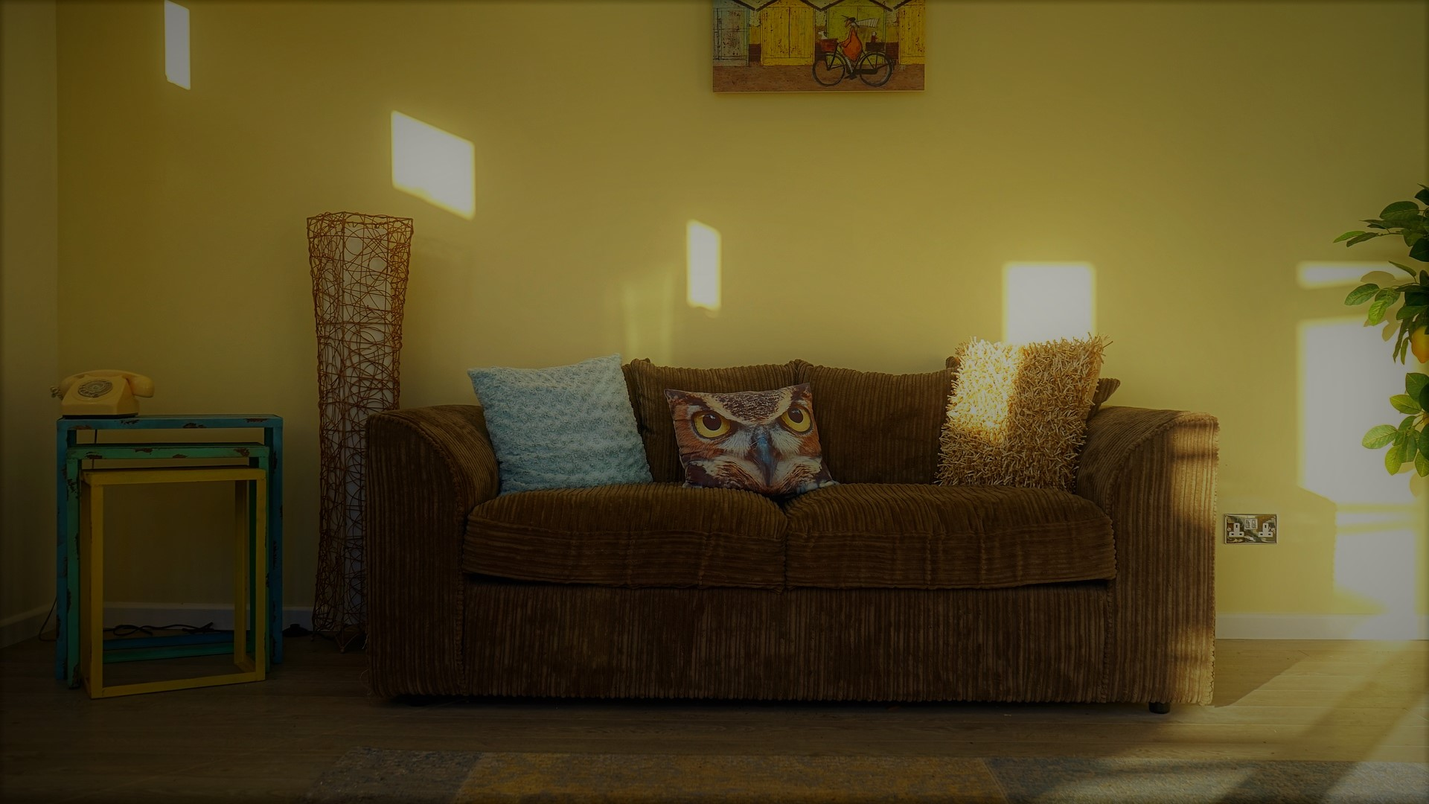
Impact at Home
Problem Behaviour
Chore completion
Avoidance
Attendance
Socialization
Overly Controlling
Daily Activities
Memory
Notes:
How might this behaviour show up at home?
Participants can turn to the person sitting next to them and discuss if any of the impacts of anxiety on learning are similar behaviours parent may see at home.
Debrief as large group - click to reveal individual impacts when complete
Avoidance: hobbies, areas, activities, people, chores, food choices
Problem behaviour: not doing what is being asked/expected (non-compliance), arguments, stubbornness, being upset, excessive reassurance seeking, withdrawing, Fidgety/restlessness, not paying attention, yelling, aggression (stems from the ‘fight’ response)
Chore Completion: need to complete tasks perfectly, taking too long, procrastinating, not doing chores
Socialization: limited interaction with friends, does not initiate social activities, bullying, victimization
Daily activities: refusal to engage in activities, daily life – errands, social activities
Overly controlling – decreases uncertainty; makes things feel safer, more predictable

Slide 14
EASE at Home
EASE lessons have been adapted for use by parents and caregivers
For more information please visit:
www.healthymindsbc.gov.bc.ca
Notes:
Introduce EASE at Home. **If internet access available, facilitators may wish to go on the site, show participants where EASE at Home is on the Healthy Minds BC website and open one activity.
Some EASE classroom lessons have been adapted for use by parents and caregivers to support their children’s mental health across home and school.
EASE at Home activities are available as downloadable PDFs in both English and French.

Slide 15
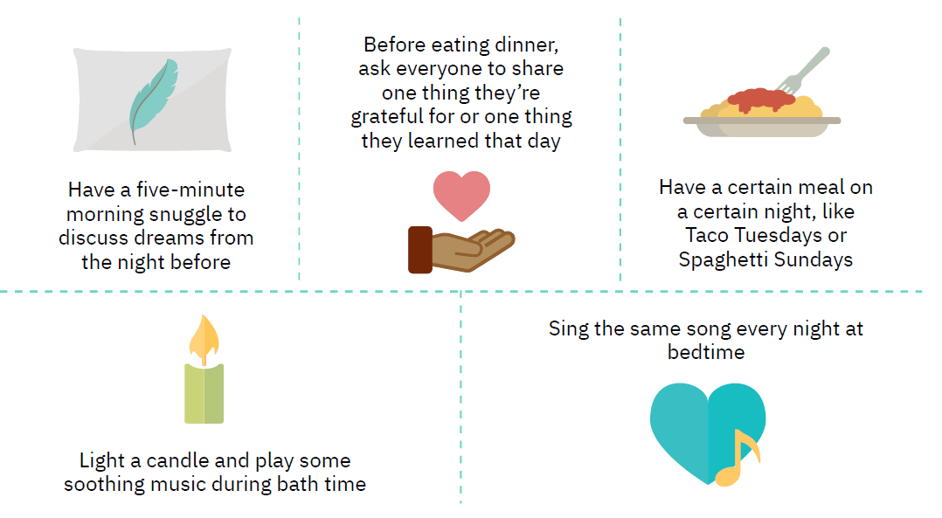
Creating Rhythm and Routines Daily Schedule
Notes:
Introduce EASE at Home activity Creating Rhythms and Routines (Grades K – 3)
When the world feels upside down, following a schedule that includes some calming routines can help create a sense of order.
Involve your child in creating a daily schedule that works for your family. With younger children, map out the day using pictures or drawings.
Examples include:
Have a five-minute morning snuggle to discuss dreams from the night before
Before eating dinner, ask everyone to share one thing they’re grateful for or one thingthey learned that day
Ask participants to work in partners and brainstorm daily routines they already engage in or things they can begin to do to create a daily schedule.

Slide 16
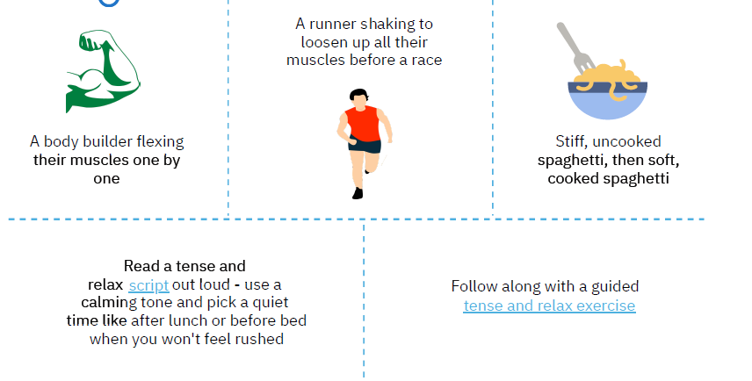
Relaxation Skills: Tense & Relax
Notes:
Introduce EASE at Home activity Relaxation Skills: Tense & Relax (Grades 4 – 7)
As we’ve learned, when kids and adults feel worried, their body tenses up. This can feel uncomfortable and make us feel uneasy. Tense and Relax involves children learning to tense up, hold, and completely relax each muscle group, one at a time.
Ask participants to join you in practicing a few tense and relax activities. Lead participants through a tense and relax exercise.
Relaxation Script
Hands and Arms
Pretend you are squeezing a whole lemon in your left hand. Squeeze it hard. Try to squeeze all the juice out. Feel the tightness in your hand and arm as you squeeze. Now drop the lemon and relax. See how much better your hand and arm feel when they are relaxed. Repeat on the other side.
Arms and Shoulders
Pretend you are a furry, lazy cat. You want to stretch. Stretch your arms out in front of you. Raise them up over your head. Way back. Feel the pull in your shoulders. Stretch higher. Now just let your arms drop back to their side. Stretch again. Repeat.
Shoulder and Neck
Now pretend you are a turtle. You’re sitting out on a rock, by a nice, peaceful pond, just relaxing in the warm sun. It feels nice and warm and safe here. Uh-oh! You sense danger. Pull your head into your house. Try to pull your shoulders up to your ears and push your head down into your shoulders. Hold in tight. It isn’t easy to be a turtle in a shell. The danger is past now. You can come out into the warm sunshine and once again you can relax and feel the warm sunshine. Watch out now. More danger. Hurry, pull your head back into your house and hold it tight.
Jaw
You have a giant jawbreaker bubble gum in your mouth. It’s very hard to chew. Bite down on it. Hard! Let your neck muscles help you. Now relax. Just your jaw hand loose. Notice how good it feels just to let your jaw drop. Okay, let’s tackle that jawbreaker again now. Repeat.
Note: Facilitators may wish to print out script (See link below).
https://depts.washington.edu/uwhatc/PDF/TF-%20CBT/pages/4%20Emotion%20Regulation%20Skills/Client%20Handouts/Relaxation/Relaxation%20Script%20for%20Younger%20Children.pdf

Slide 17
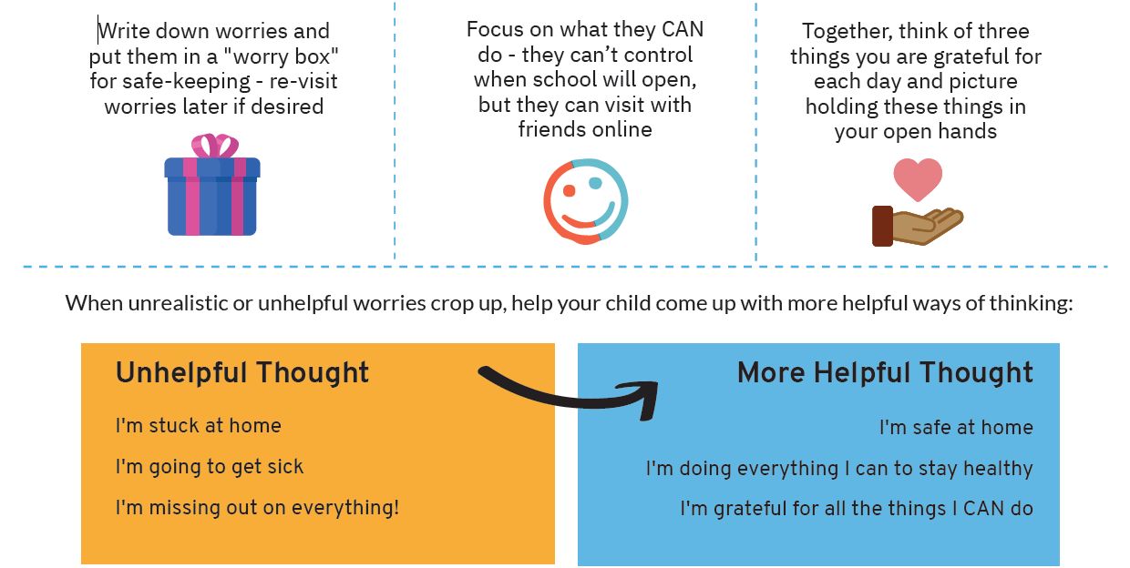
Creating a Helpful Mindset
Notes:
Introduce EASE at Home activity Creating a Helpful Mindset (Grades 4 – 7)
Another helpful tool is creating a helpful mindset.
Parents and caregivers can help children express and cope with worries and change unrealistic or overly negative thoughts into more helpful thoughts.
Talking to your child about their worries lets them know that they’re not alone. Many worries are about the future or things that could happen, so asking “What if?” may help them talk about what's on their mind.
The following suggested activity could be done as individual work.
Participants write down worries and put them in a "worry box" for safe-keeping - re-visit worries later if desired
Together, think of three things you are grateful for each day and picture holding these things in your open hands

Slide 18
Notes:
https://healthymindsbc.gov.bc.ca/resources/ease-at-home-4-7-collection/

