Slide 1
Camp Jubilee April 19-21
Tomekichi Homma Presents Outdoor Education at

Slide 2
What is Outdoor Education?
Jubilee Outdoor School Programs are about exposing students to nature and outdoor activities in a way that is safe, informative, and exciting. All of the programs are designed with these goals in mind and are facilitated by our trained and experienced instructors.

Slide 3
Where is Camp Jubilee located?
The adventure begins in the waterfront village of Deep Cove, North Vancouver BC. We will board one of the passenger vessels for a 30-minute voyage up Indian Arm from the Gallant Wharf in Deep Cove, North Vancouver.

Slide 4
What will my child do at Outdoor Ed?
Jubilee offers twelve unique 90 minute outdoor activities to choose from that will be customized to meet the needs of Homma. Activities such as kayaking, high ropes, hiking, canoeing, rock climbing, beach study and much more are offered.

Slide 5
Who attends Camp with my child?
There will be 13 Homma Staff Members attending Camp Jubilee with your child along with additional Jubilee staff.

Slide 6
What will my child eat at Camp?
A sampling of Meals served at Camp Jubilee:
Breakfast - Breakfasts are served with juice, cereal, toast and fruit
Pancakes and Sausage
Bacon and Eggs
Waffles and Ham
Breakfast Wrap
Lunch – Lunch is served with salad and/or homemade soup
Chicken Fingers
Sandwich Bar
Hamburgers and Fries
Chicken Burgers and Salad
Dinner – Dinner is served with a salad bar
Penne with Meat Sauce
Roast Beef
Lasanga
Chicken Dinner
Meal times are generally 8:30am for breakfast, 12:30pm for lunch, 5:30pm for dinner and 9:00 pm for snack. Refreshments between meals consist of coffee, tea, and seasonal fruit to keep all our guests well nourished throughout their stay.
Camp Jubilee can accommodate most special diets including vegetarians, vegan, gluten free, pork free, nut free etc.

Slide 7
Where will my child sleep at camp?
Students will have the opportunity to request two or three friends they would like to room with at camp
Cabins are separated by gender
Staff sleep in the lodge but patrol the grounds regularly
Sleeping Arrangements

Slide 8
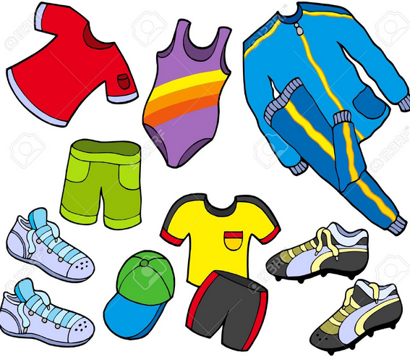
What does my child need to bring to Camp?
Each student may bring 1 backpack and 1 bag with a sleeping bag and pillow
Please have your child pack their own items (with your support) so they know what they have in their bag!
We will be sending a packing list home but please remember that West Coast weather can be unpredictable!!!
Don’t forget a Water Bottle!

Slide 9
What does a typical day look like at Camp?

Slide 10
Financials – Cost Per Child
Camp Jubilee $287
Bus Cost $20
TTOC Cost $33
TOTAL COST $340

Slide 11
Next Steps…
Thank you for paying the deposit of $100.
Pay your first installment through Cash On Line - $120 – on or by February 17, 2023
For water activities please provide the office with a copy of
The following will be sent home this week: Please complete and return by March 10th
Sign the district Parental Consent Form / Sign and complete the Camp Jubilee consent form
Complete the Districts Emergency Medical Form
Complete the Dietary Needs Form (if applicable)
Review, discuss the Code of Conduct
Pay the second installment through Cash on Line - $120 – on or by March 10, 2023

Slide 12
What you need to know!
All Camp Jubilee staff are first aid trained
In the event of an emergency, we will notify you immediately
Cell phones and iPads are not permitted at Camp
Children are not permitted to use the phone at the camp
Please do not send any food or snacks with your child – these items will attract both big and small animals
Heat Treatment process

Slide 13
Questions???

